Slide 1
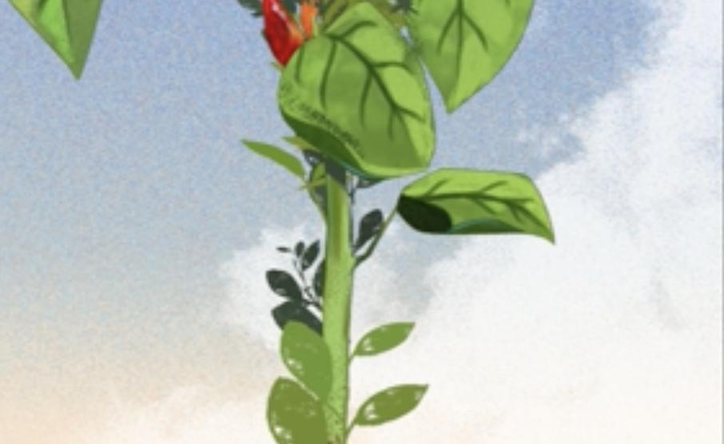
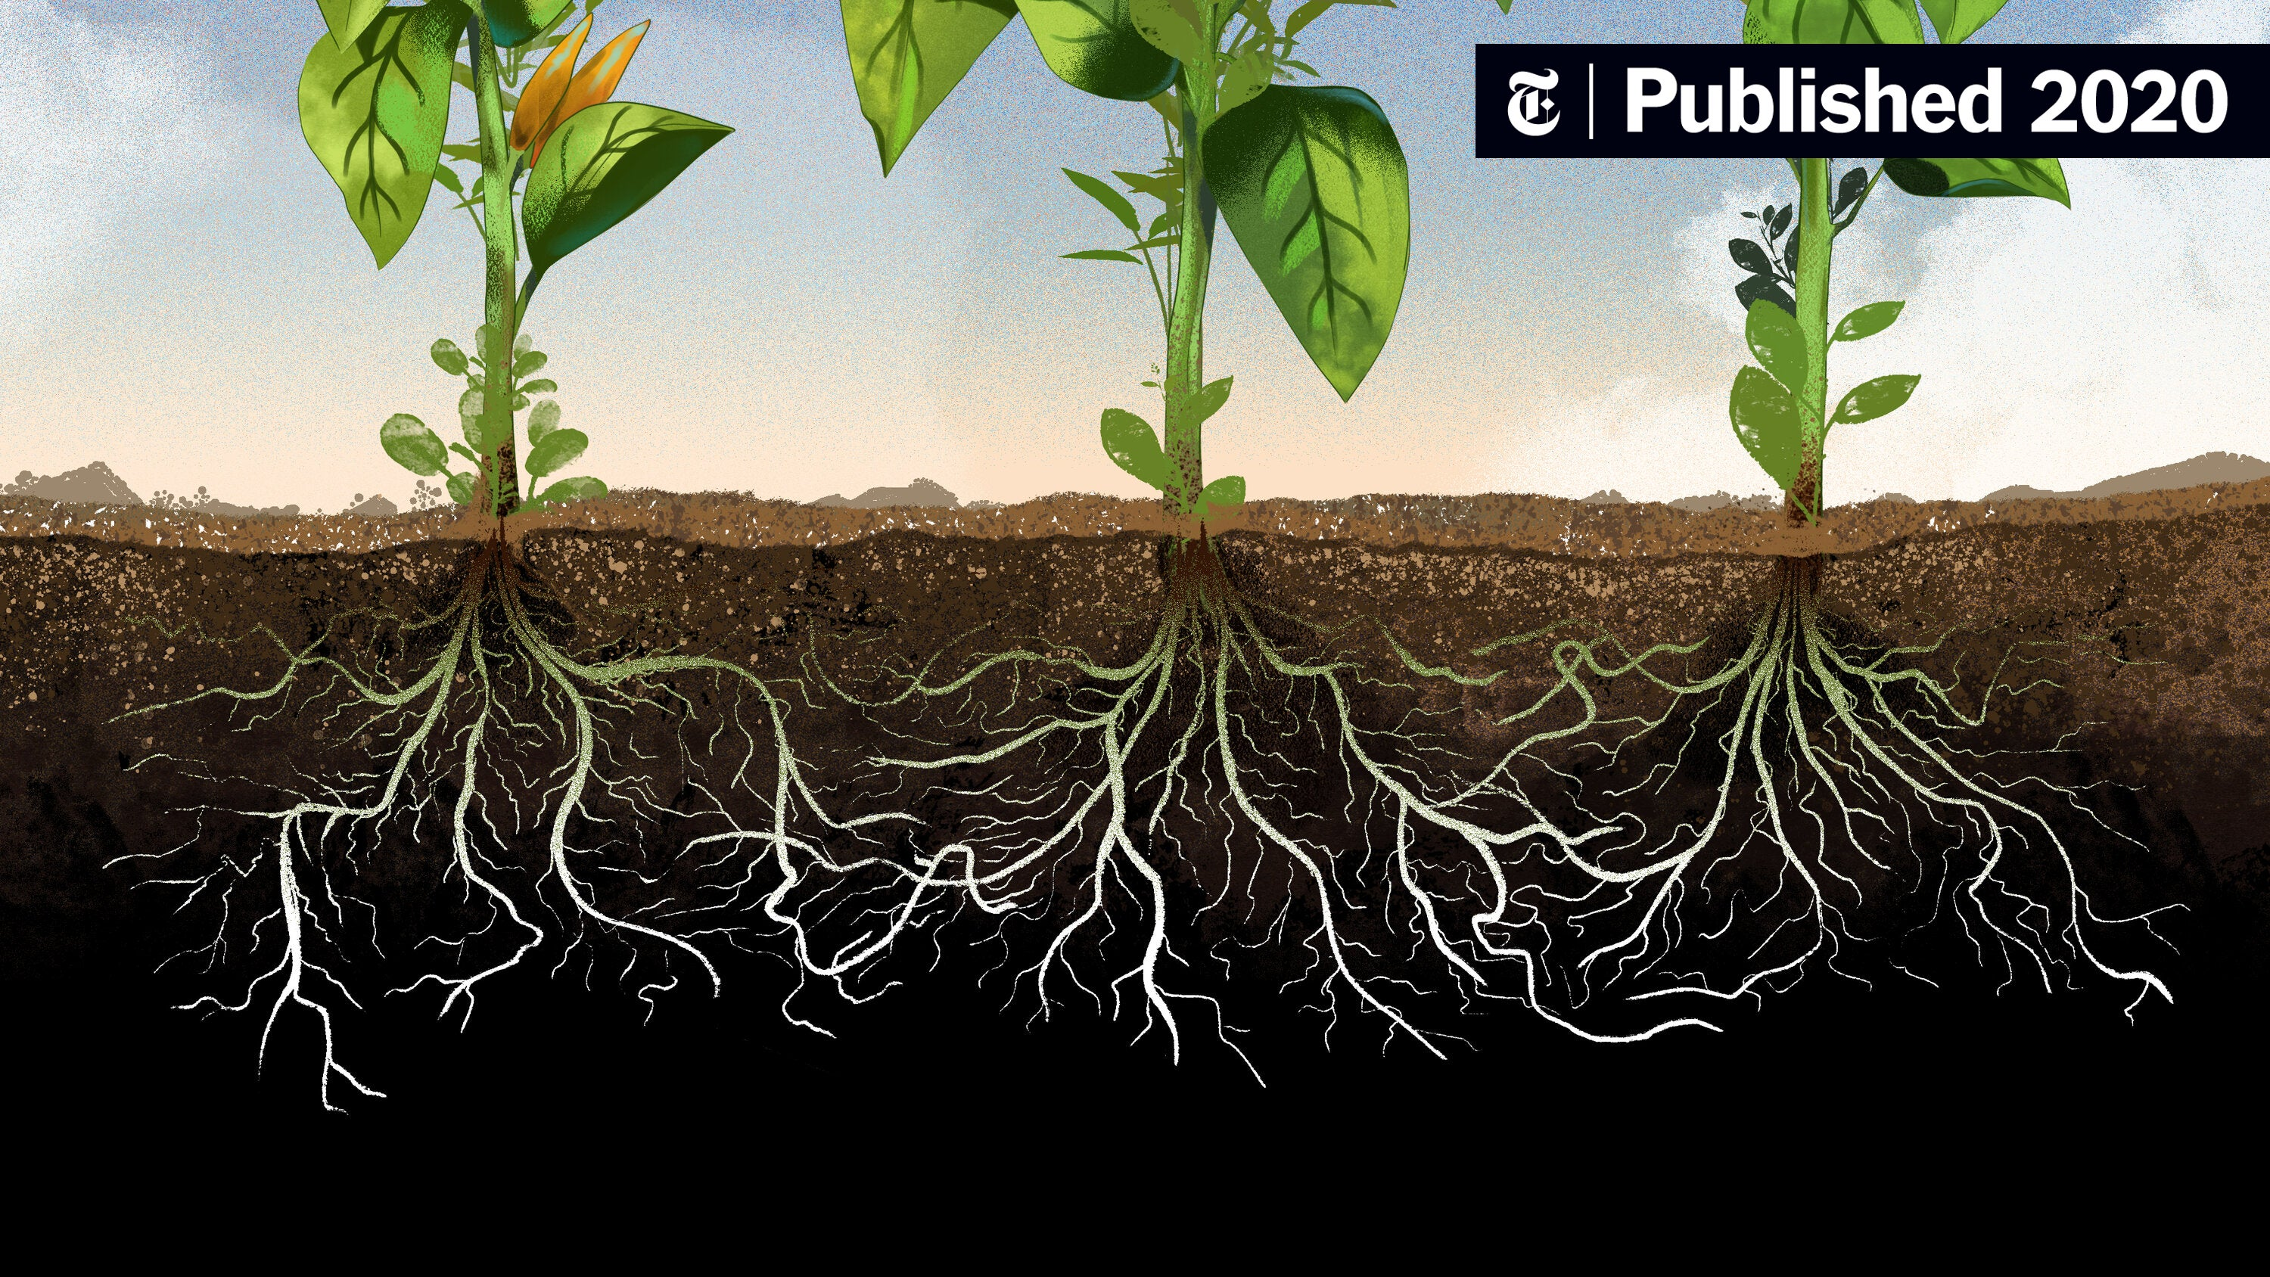


Slide 2
Roots are important (model organs, video from Paper)

Slide 3
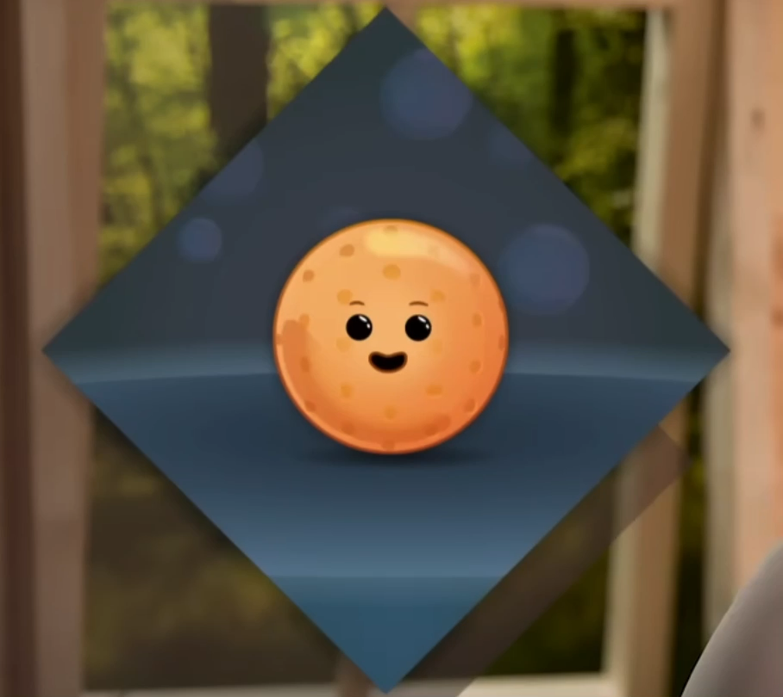
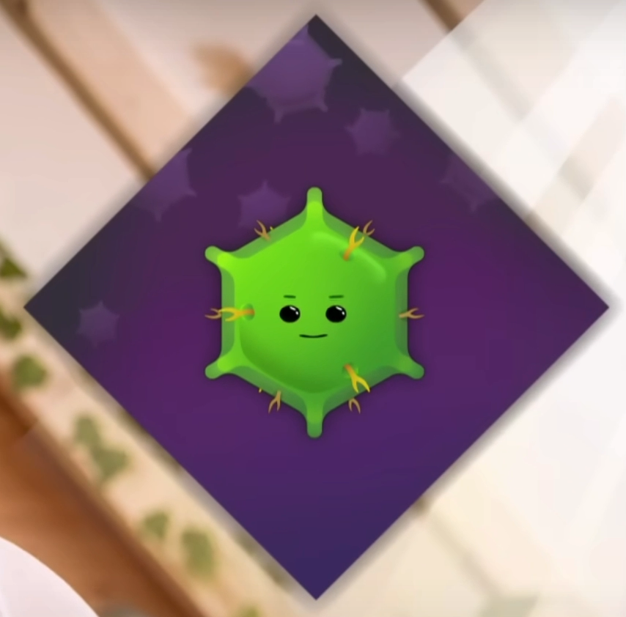
Plant cells physics are different from bacteria/animals

Slide 4
Physics

Slide 5
Plant agent-based model (Jan’s video)

Slide 6
Root development biology (figure)

Slide 7
Future extensions of using agent based models

